Slide 1
Neural Networks
Data Analytics - WQD 7003

Slide 2
Neural Networks
A neural network can be defined as a model of reasoning based on the human brain. The brain consists of a densely interconnected set of nerve cells, or basic information-processing units, called neurons.
The human brain incorporates nearly 10 billion neurons and 60 trillion connections, synapses (junction), between them. By using multiple neurons simultaneously, the brain can perform its functions much faster than the fastest computers in existence today.
Each neuron has a very simple structure, but an army of such elements constitutes a tremendous processing power.
A neuron consists of a cell body, soma, a number of fibers called dendrites, and a single long fiber called the axon.

Slide 3
Biological Neural Networks
Signals are propagated from one neuron to another by electro chemical reactions.
Chemical substances released from Synapses cause a change in the electrical potential of the cell body.
The pulse spreads out and eventually reaches synapses causing them to increase or decrease its potential

Slide 4
How do Artificial Neural Networks Model the Brain?
An artificial neural network consists of a number of very simple processors, also called neurons, which are analogous to the biological neurons in the brain.
The neurons are connected by weighted links passing signals from one neuron to another.
The output signal is transmitted through the neuron’s outgoing connection. The outgoing connection splits into a number of branches that transmit the same signal. The outgoing branches terminate at the incoming connections of other neurons in the network.

Slide 5
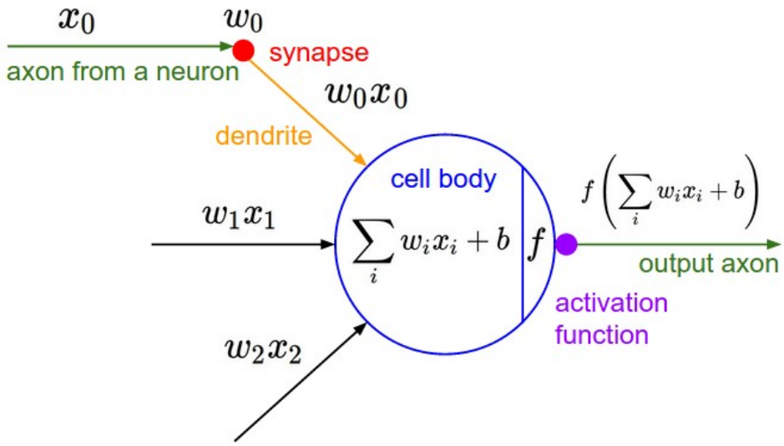
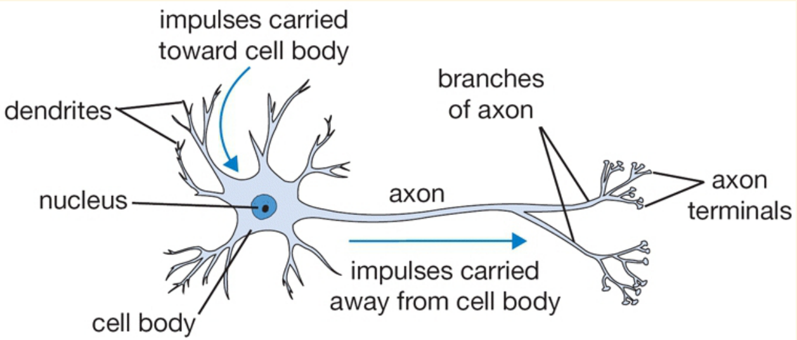
Neural Networks
Notice that the network of nodes I have shown only sends signals in one direction. This is called a feed-forward network. The one-directional nature of feed-forward networks is probably the biggest difference between artificial neural networks and their biological equivalent.
This object is called a perceptron. A perceptron takes a number of binary inputs and emits a binary output.

Slide 6
Neural Networks - How does a perceptron learn?
A perceptron has initial (often random) weights typically in the range of [-0.5, 0.5].
Apply an established training dataset.
Calculate the error as expected output minus actual output:
error e = Y_{expected} – Y_{actual}
Adjust the weights to reduce the error.

Slide 7
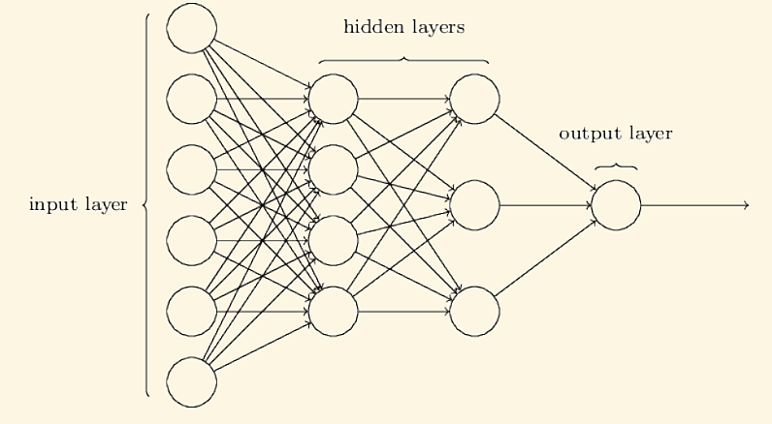
Multi-Layer Perceptron (MLP)
MLP consists of hidden layers between input and output layers. Each layer connects N input units to M output units.

Slide 8
Multi-Layer Perceptron (MLP)
The simplest kind of feed-forward network is a multilayer perceptron (MLP).
The units are arranged into a set of layers, and each layer contains some number of identical units. Every unit in one layer is connected to every unit in the next layer; we say that the network is fully connected.
The first layer is the input layer, and its units take the values of the input features. The last layer is the output layer, and it has one unit for each value the network outputs (i.e. a single unit in the case of regression or binary classification, or K units in the case of K-class classification).
All the layers in between these are known as hidden layers, because we don’t know ahead of time what these units should compute, and this needs to be discovered during learning.

Slide 9
Advantages of Neural Networks
They are extremely powerful computational algorithm.
Massive parallelism makes them very efficient.
They can learn and generalize from training data – so there is no need for enormous feats of programming.
They are very noise tolerant – so they can cope with situations where normal systems would have difficulty.

